Slide 1
Activity, Intent and UI design
Università di Modena e Reggio Emilia

Slide 2
Introduction
In this module are explained the basis of android app.
Will be discussed:
How android OS manages processes
Android app core components
How apps manage intra-communications
How to use basic UI components: layout and widget
How to manage basic interactions with user and events

Slide 3
Application life-cycle and priority
Apps have limited control over their lyfe-cycle.
Every Android application runs in its own Linux process.
Memory and process management is handled by ART. Android assigns resources and determines which processes should be killed on the basis of process priority:
Active process (Top Priority): have active components which is interacting with user (e.g. user is typing in a search box)
Visible process (High Priority): visible but inactive components (e.g. an activities partial obscured by a pop up element)
Started background service process (Medium priority): hosting backgroud services that have been started
Background process (Low Priority): hosting activities wthat aren’t visible and don’t have running services (e.g. when you tap home screen or recent applications button, activity that was running go in background)

Slide 4
Application class
The Application class, or any subclass of the Application class, is instantiated before any other class when the process for your application/package is created. Application class is implemented using singleton design pattern.
Extending this class you can:
Manage global initialization
Respond to application-level events broadcast by ART (like low memory condition)
Rarely extend application class is necessary

Slide 5
Application core components
App is composed by several elements, bounded in Android Manifest (which describe each of them and how they interact)
Activities: app presentation layer. The app’s UI is built around activities, which use Views and Fragments to display info and interact with user
Services: run without UI (update data, trigger notifications…)
Broadcast receivers: used to configure app to listen only Intents that match your specifications
Content providers: used to share data across application boundaries
Intents: inter and intra application way to exchange massages, you can start Activities, Services…
Notifications: used to alert user to application events without interrupting current Activity

Slide 6
Activity

Slide 7
Activity
Unlike programming paradigms in which app are launch with a main(), the Android system initiates code in an Activity by invoking specificic method.
Why? In mobile-app, user's interaction doesn't always begin in the same place (e.g. app could be started with the launch icon and user might see a specific window, but, it could be started also using another app and user might se another different window). Activity is designed to facilitate this paradigm, it serves as the entry point for an app's interaction with the user
An activity provides the window in which the app draws its UI and is an entry point for the interaction of an app with the use

Slide 8
Activity lifecycle
When user navigate through an app, the Activity instances transition through different states of their lifecycle.
Activities in the system are managed as activity stacks by ActivityManager using LRU-mechanism (Last Recently Used: When a new activity is started, it is usually placed on the top of the current stack and becomes the running activity -- the previous activity always remains below it in the stack, and will not come to the foreground again until the new activity exits.)
Entire lifecycle is related to specific methods which are invoked by the system; developers can override them

Slide 9
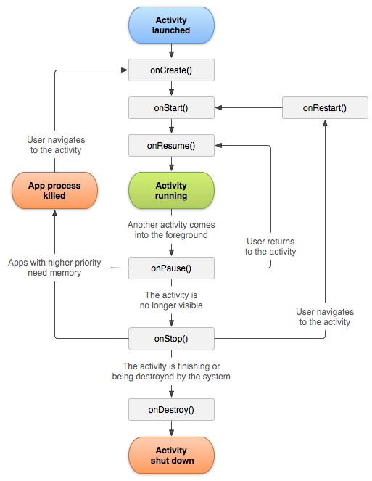
Activity lifecycle
Activity has 4 states (represented by oval):
Active or running: if activity is in the foreground of the screen (it is at the top of the stack). The user is interacting with.
Visible: If activity has lost focus but is still presented to the user (e.g. if activity has partial obscure by a pop-up) (activity is alive and maintains all information)
Stopped or hidden: if activity is completely obscured by another activity. (it maintains information but it could be killed by the system)
Destroyed: if activity is dropped from memory

Slide 10
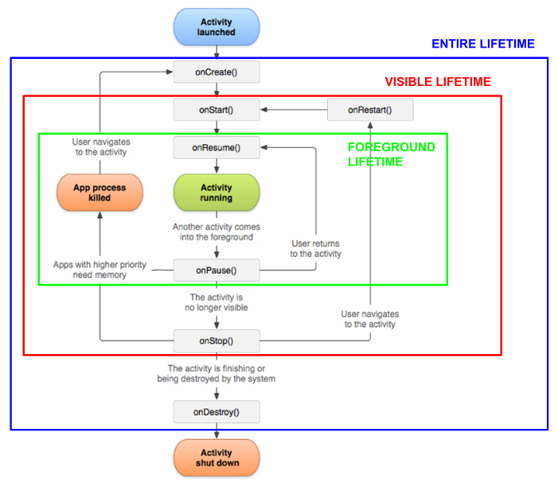
Activity lifecycle
We can distinguish 3 loops:
Entire lifetime: from onCreate(), where activity setup global stae, until onDetroy(), where activity release all resources
Visible lifetime: from onStart() until onStop(), user can see the activity on screen, but it couldn't be in foreground
Foreground lifetime: from onResume() until onPause(), user is interreacting with activity

Slide 11
Activity class
Activity class takes care of creating a window for you in which you can place your UI
Is located in android.app package
Extends ApplicationContext which is an implementation of Context, represent an interface to global information about an application environment. This is an abstract class whose implementation is provided by the Android system. It allows access to application-specific resources and classes, as well as up-calls for application-level operations such as launching activities, broadcasting and receiving intents, etc.
public abstract Context getApplicationContext() is an abstract method which return a context
https://developer.android.com/reference/android/app/Activity

Slide 12
Activity class methods
public class Activity extends ApplicationContext {
protected void onCreate(Bundle savedInstanceState) //
protected void onStart() //
protected void onRestart() // Managing protected void onResume() // activity
protected void onPause() // lifecycle
protected void onStop() //
protected void onDestroy() //
public void finish() //
public void setContentView (View view) //
public T findViewById (int id) // Managing UI
public void setContentView (int id) //
protected void onSaveInstanceState (Bundle outState) // Save and restore
protected void onRestoreInstanceState (Bundle savedInstanceState) // UI state
}

Slide 13
Activity class methods
Activity class provide setContentView method which is used to present UI layout, Both the width and the height of the view are set by default to match_parent (full screen)
public void setContentView(View view): Set the activity content to an explicit view. This view is placed directly into the activity's view hierarchy. If you create UI using java class, you must use this.
public void setContentView(int layoutId): Set the activity content from a layout resource. Int is the resource id to be inflated, which can be accessed using R class (R.layout.ResourceId)
setContentView(R.layout.activity_main)

Slide 14
Activity class methods
public T findViewById (int id)
Activity and View class provide this generic method to allow the creation of View-subclass instances from a Resource id.
public void setContentView (int id)
You can manage only views which are included in layout set with setContentView, in other words, only the id which are contained in layout xml file
Depending on compiler support, explicit casting of view which is returned is necessary or not.
TextView tvTitolo = findViewById(R.id.tv_titolo)

Slide 15
Activity class methods
public void finish()
Call this when your activity is done and should be closed.

Slide 16
Managing activity lifecycle
Developer can modify and manage activity lifecycle using 6 methods, which are called by the system at every state transition
If you override this methods, you must call through to the superclass implementation.
at the end of all state transictions activity send to each related components (views, fragment, …) specific event (e.g. at the end of onCreate() send ON_CREATE event).
Lifecycle class contain states and events of a general Android lifecycle
protected void onCreate(Bundle savedInstanceState)
protected void onStart() protected void onRestart() protected void onResume() protected void onPause() protected void onStop()
protected void onDestroy()

Slide 17
onCreate(Bundle)
This method is required.
Called when the activity is first created, it enters in the created state.
If Activity was already created, but it was you can restore previous information stored by activity, using Bundle param
=====================================
BEST PRACTISE: in this method you perform basic application startup logic that should happen only once for the entire life of the activity. (e.g. declaring the user interface (defined in an XML layout file), defining member variables, and configuring some of the UI, using setContentView and findViewById methods )

Slide 18
onStart()
When the activity enters the Started state, the system invokes this method
onStart() call makes the activity visible to the user but it isn't already interactive
Called after onCreate() or onRestart() when the activity had been stopped, but is now again displayed to the user
Once the execution of onStart() finishes, activity enters in Resume state and system invokes onResume()
===================================
BEST PRACTISE: this method is where the app initializes the code that maintains the UI, onStart() execution is quickly don't use it for heavy operations

Slide 19
onResume()
When the activity enters the Resumed state, it comes to the foreground, and then the system invokes onResume(). This is the state in which the app interacts with the user.
The app stays in this state until something happens to take focus away from the app, in which case activity enters the Paused state, and system invokes onPause()
If the activity returns to the Resumed state from the Paused state, the system once again calls onResume()
=====================================
BEST PRACTISE: In this method you should updates any UI components which will be displayed to the user

Slide 20
onPause()
Called as part of the activity lifecycle when the user no longer actively interacts with the activity, but it is still visible on screen.
At the end of execution, Activity remains in paused state until activity resumes or become completely invisible.
=====================================
BEST PRACTISE: Use onPause() to pause operations and release system resources that should not continue while activity in in paused state, NOT use onPause to save user data or do other "heavy" operation, such as database-transaction.

Slide 21
onStop()
Called when activity are no longer visible to the user, but it is active) and enters in Stopped state.
From the Stopped state, if the user navigate to the activity system call onRestart() method and the activity is placed on the top of the stack; instead, if the system need memory, it calls onDestroy() methods.
=======================================
BEST PRACTISE: this is a good place to release resources that are not needed while the app is not visible to the user, such us stop refreshing UI, running animations and other graphical tasks.
You can use onStop() to perform CPU-intensive operations, such us save information to a database

Slide 22
onRestart()
Called after onStop() when the currently activity is being re-displayed to the user.

Slide 23
onDestroy()
Is called before the activity is destroyed and enters Destroyed state, system invokes this method because:
The activity is finishing (user dismissing activity or finish() being called)
System is temporarily destroying activity ( such us in device rotation)
If the activity is finishing, onDestroy() is the final lifecycle callback the activity receives.
If onDestroy() is called as the result of a configuration change, the system immediately creates a new activity instance and then calls onCreate() on that new instance in the new configuration
===========================================
BEST PRACTISE : This method is usually implemented to free resources like threads that are associated with an activity.

Slide 24
Resume
CALLBACK | WHAT HAPPENS | BEST CODING PRACTISE
ONCREATE() | Called when the activity is created for the first time | Initialize UI and variables
ONSTART() | Called when the activity became visible to the user, but it isn't already interactive | Start graphic animations or transitions and get initial values to display
ONRESUME() | Called when the activity is in foreground and interactive | Start operations which must be active only when activity is interactive: update the data to be displayed
ONPAUSE() | Called when another activity goes in foreground | Stop animations
ONSTOP() | Called when the activity is no longer visible and goes in background | Stop operations that are no longer needed when activity is no longer visible
ONDESTROY() | Called when the activity is destroyed | Release the allocated resources
ONRESTART() | Called when the activity is restarted after being interrupted

Slide 25
Saving and restoring UI state
There are 2 scenario in which activity is destroyed by the system:
User press back button, this action represent a finish() call
System destroyed activity which isn't in foreground to preserve resources
In the first scenario, you not have to do anything because user's expectation corresponding to the system behaviour.
In the second scenario, if the user want to navigate back to the activity the system create a new instance of that activity using a set of saved data that describes the state of the activity when it was destroyed.
The saved data that the system uses to restore the previous state is called the instance state and is a collection of key-value pairs stored in a Bundle object.
By default, the system uses the Bundle instance state to save information about each View object in your activity layout. However, your activity might have more state information that you'd like to restore, such as member variables that track the user's progress in the activity.

Slide 26
Bundle
Used across process boundaries such us with IPC (inter-process communication) transactions, between activities with intents or to store state across configuration changes.
Parcelable is an interface for classes whose instances can be written to and restored from a Parcel (Container for a message, data and object references, that can be sent using IPC, inter-process communication)
Bundle is a mapping String key-Parcellable values
Bundle class provide getters and put methos which allow you to pick-up and to insert data

Slide 27
Saving state
protected void onSaveInstanceState (Bundle outState)
Used to save simple and lightweight UI states from an activity before being killed, that the state can be restored in onCreate() or onRestoredInstanceState().
The default implementation takes care to save the state of the view hierarchy, calling View.onSaveInstanceState() for each view.
static final String STATE_SCORE = "playerScore"; static final String STATE_LEVEL = "playerLevel"; // ... @Override public void onSaveInstanceState(Bundle outState) { // Save the user's current game state savedInstanceState.putInt(STATE_SCORE, currentScore); savedInstanceState.putInt(STATE_LEVEL, currentLevel); // Always call the superclass so it can save the view hierarchy state super.onSaveInstanceState(savedInstanceState); }

Slide 28
Restore state
protected void onRestoreInstanceState (Bundle savedInstanceState)
This method is called after onStart() when the activity is being re-initialized from a previously saved state, given her in savedInstanceState.
The default implementation of this method performs a restore of any view state that had previously been frozen by onSavedInstanceState()
@Override protected void onCreate(Bundle savedInstanceState) { super.onCreate(savedInstanceState); // Always call the superclass first // Check whether we're recreating a previously destroyed instance if (savedInstanceState != null) { // Restore value of members from saved state currentScore = savedInstanceState.getInt(STATE_SCORE); currentLevel = savedInstanceState.getInt(STATE_LEVEL); } else { // Probably initialize members with default values for a new instance } // ... }
=====================================================================
public void onRestoreInstanceState(Bundle savedInstanceState) { // Always call the superclass so it can restore the view hierarchy super.onRestoreInstanceState(savedInstanceState); // Restore state members from saved instance currentScore = savedInstanceState.getInt(STATE_SCORE); currentLevel = savedInstanceState.getInt(STATE_LEVEL); }

Slide 29
AppCompatActivity
AppCompatActivity is a Activity sub-class , it provides backward compatibility for features added to the Activity class in each new platform release (wish to use some of the newer platform features on older Android devices).
During the course we will use it.
Some of these backported features include:
Using the action bar, including action items, navigation modes
Built-in switching between light and dark themes
Integration with DrawerLayout
Support Fragments (because it extends FragmentActivity)

Slide 30
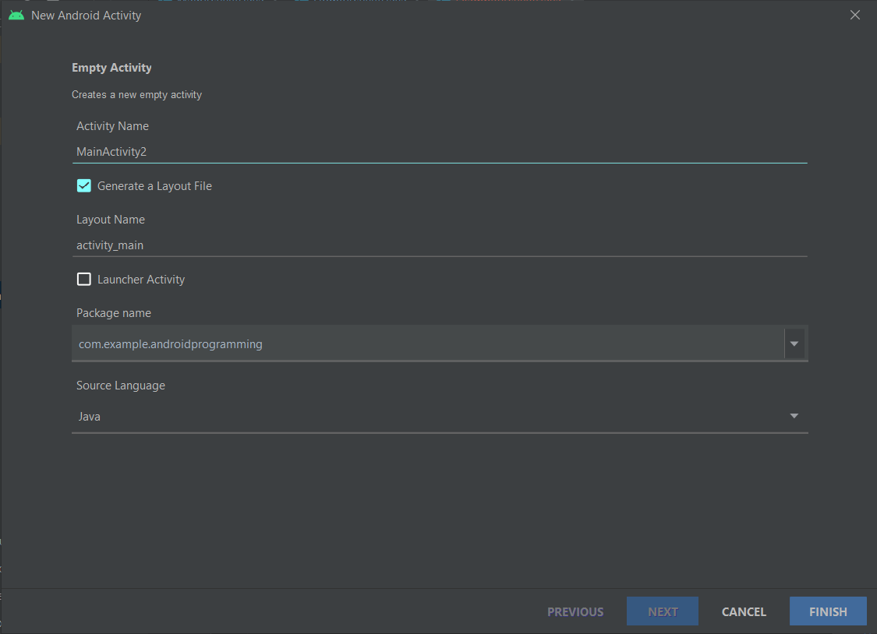
Activity creation
Every activities, to be used, must have an associated <activity> tag in AndroidManifest.xml
Android Studio takes care to do this for you
Right click on destination activity code package -> new -> activity -> choose activity type
You must choose:
Activity name
Associated layout file
Destination package
Source language
By default, android studio extends AppCompatActivity

Slide 31
INTENTS

Slide 32
Intents
Are a message-passing mechanism, you can use intents to request an action from another app component.
Are fondamental used for:
Starting activities
Interact with other app (https://developer.android.com/guide/components/intents-common)
Delivering a broadcast
Starting a service
https://developer.android.com/guide/components/intents-filters

Slide 33
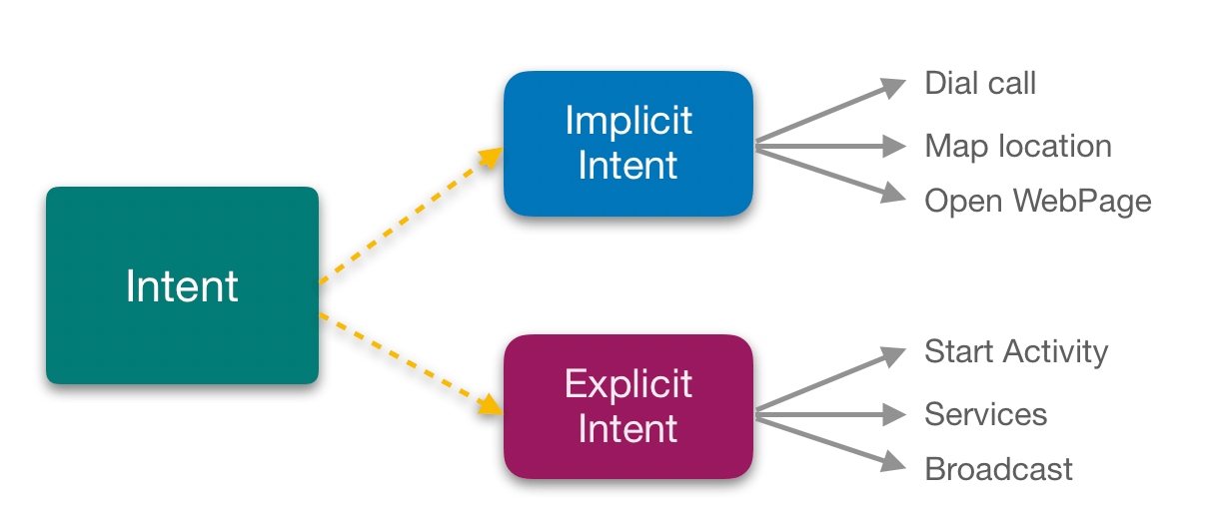
Explicit and implicit intents
There are 2 types of intents:
Explicit intents: specify which application will satisfy the intent, by supplying either the target app's package name or a fully-qualified component class name. (e.g starting activity)
Implicit intents: do not name a specific component, but instead declare a general action to perform, which allows a component from another app to handle it. (e.g send email)

Slide 34
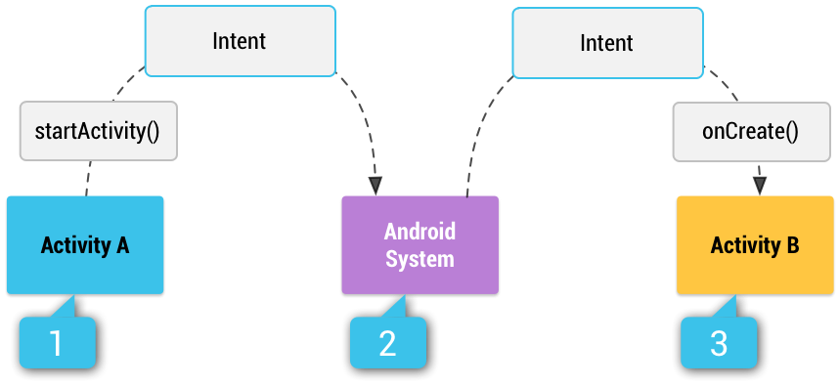
Implicit intents and Intent filters
If you use implicit intents, system compare the contents of your intent to intent filters in manifest of other app on the device, then start related components.
In case of multiple intent filters user must choose (e.g. send email)
Intent filter: tag in manifest, specifies the type of intetnts that the component is able to receive

Slide 35
Building an intent
Intent(Context packageContext, Class<?> cls) is the most common constructor that create an explicit intent.
Infromation contained in intent are:
Component name: name of the component to start; if it is present intent is explicit, instead, intent is implicit.
This is represented by ComponentName field in Intent class, you can set that in Intent constructor using setComponent() method (e.g. com.example.MainActivity)
Action: a string that species the generic action. Every available action are contained in Intetn class, are representend by final static string. (e.g ACTION_SEND, ACTION_VIEW are the most common actions used to start activities)
You can set action in intent constructor or using setAction() method
Category: A string containing additional information about the kind of component that should handle the intent. (common category are CATEGORY_LAUNCHER target activity is the initial activity)
You can set category using addCategory() methods
Extras: Key-value pairs that carry additional information required to accomplish the requested action.
You can set single extra using putExtra() method or you can set a Bundle of extras using putExtras()
Flags: may instruct the Android system how to launch an activity and how to treat it after it's launched
You can set flags using setFlags() method
Data: Uri object represent data and MIME type represent type of data
You can set Uri with setData() method and set MIME using setType()
https://developer.android.com/reference/android/content/Intent

Slide 36
Actions
Android platform provide native actions:
ACTION_VIEW: common generic action
ACTION_DELETE: starts activity that lets dele the data specified in URI
ACTION_DIAL: starts dialer app (e.g. phone) with the number in URI
ACTION_EDIT: starts activity that can edit data URI
ACTION_SEARCH: starts specific search activity
ACTION_SENDTO: starts app that can send data to contact specified in URI
ACTION_SEND: starts activity that can send data URI (need MIME and EXTRAS)
ACTION_WEB_SEARCH: opens Browser

Slide 37
Starting activities
To start an activity from another one activity class provide startActivity() method that required an explicit intent
public void startActivity(Intent intent)
Intent intent = new Intent(SourceActivity.this, DestinationActivity.class) ;
startActivity(intent);
DestinationActivity will be created, started, and resumme, replacing the SourceActivity at the top of activity stack.

Slide 38
Sharing data between activities
Intent support putExtra methods, you can add data to share to the new activity
In SourceActivity:
String stringValue = "Android programming";
Intent intent = new Intent(SourceActivity.this, DestinationActivity.class) ;
Intent.putExtra("key", stringValue);
startActivity(intent);
In DestinationActivity:
Bundle bundle = getIntent().getExtras();
String stringValue = bundle.getString("key");

Slide 39
Intent Filter
Describe what action, data and categories a component can handle, defined mostly inside the manifest but may be dynamically registered in code. For each activity, services we want them to manage implicit intent we must declare intent filter.
<activity android:name=".MainActivity" android:exported="true"> <intent-filter> <action android:name="android.intent.action.MAIN" /> <category android:name="android.intent.category.LAUNCHER" /> </intent-filter> </activity>

Slide 40
Intent Resolution
When intent is fully declared is sent to the PackageManager: Class for retrieving various kinds of information related to the application packages that are currently installed on the device
1
Action
PackageManager
Category
Data

Slide 41
Intent Resolution
PackageManager compare data inside the intent and the list of activity available, his purpose is to find which who can perform intent’s action. After this comparison we can have three results:
2
Package
Manager
1
Action
Category
Data
Action
Activity

Slide 42
Intent Resolution
1
2
3
Package
Manager
Action
No activity is found to perform the action
One Activity is found and is directly launched
One or more Activity are found, the PackageManager show the list of activities found.
Category
Data
Action
Activity

Slide 43
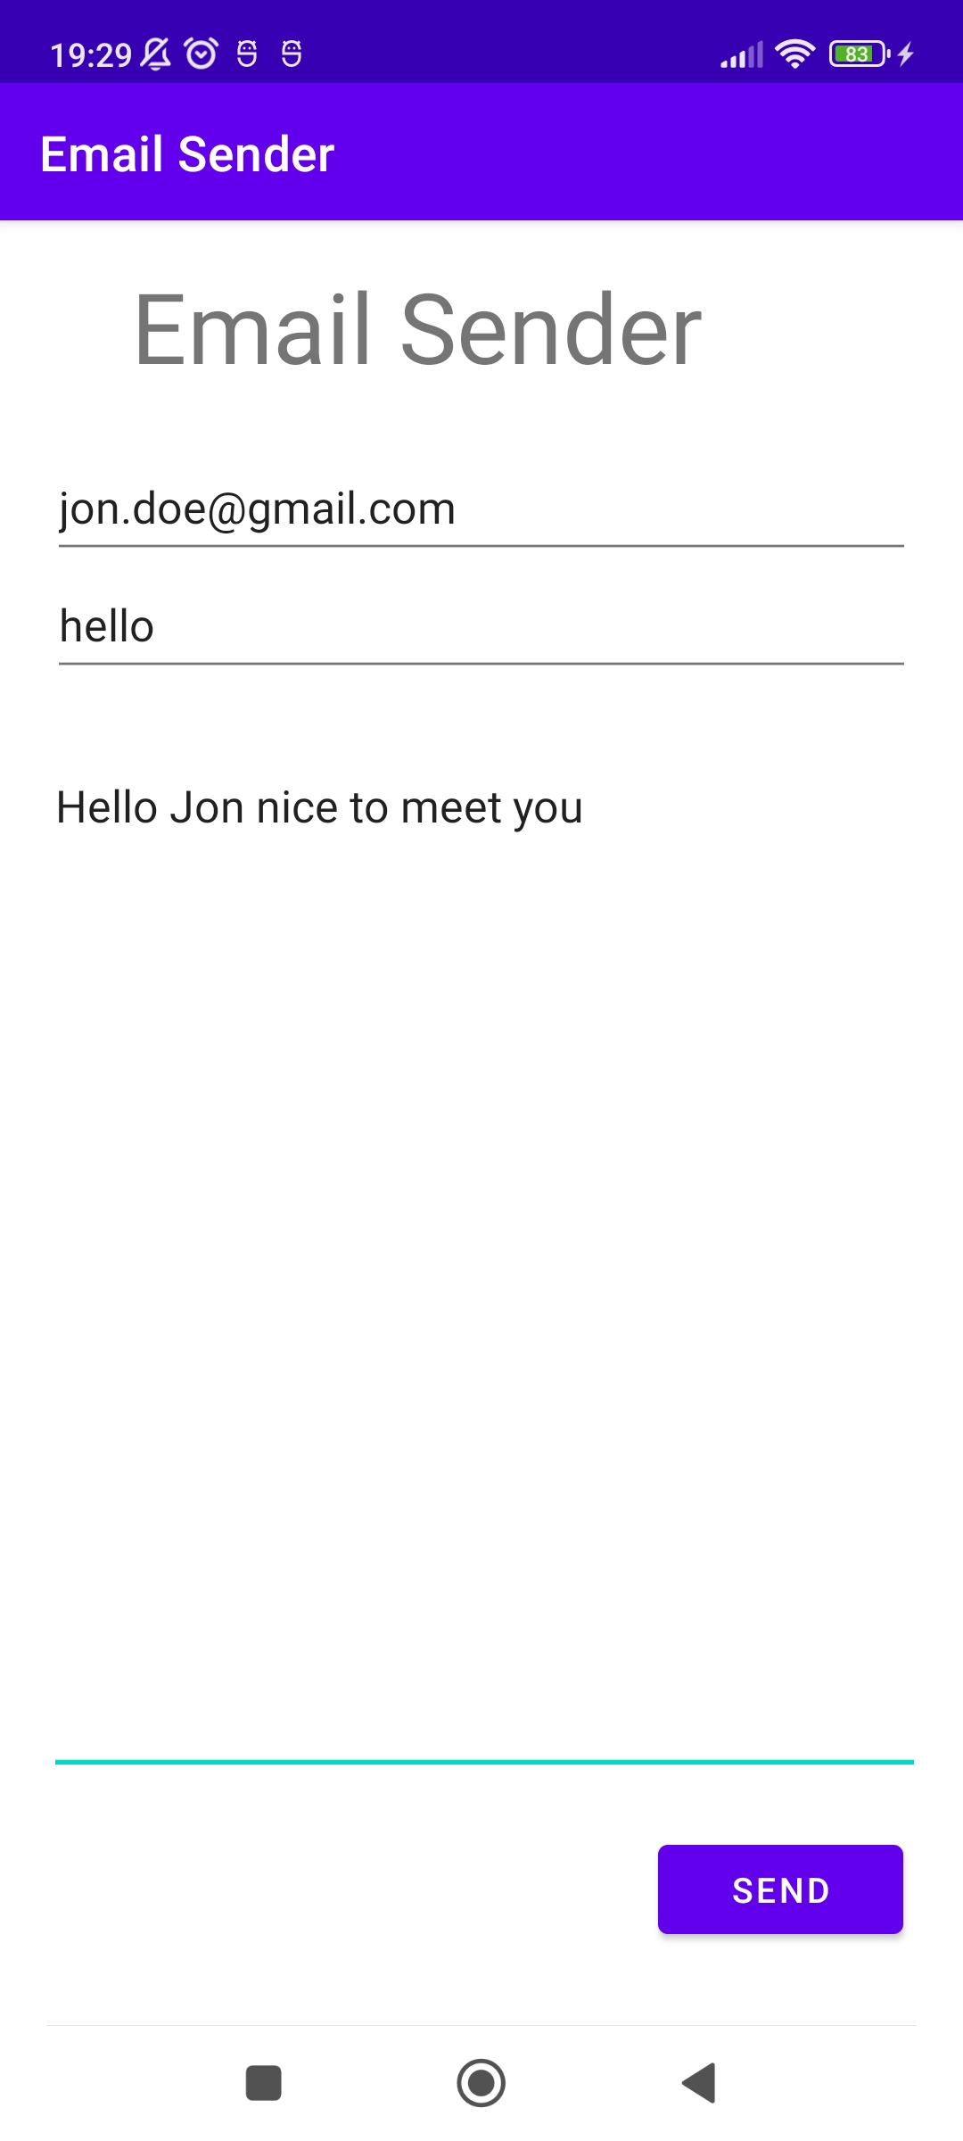
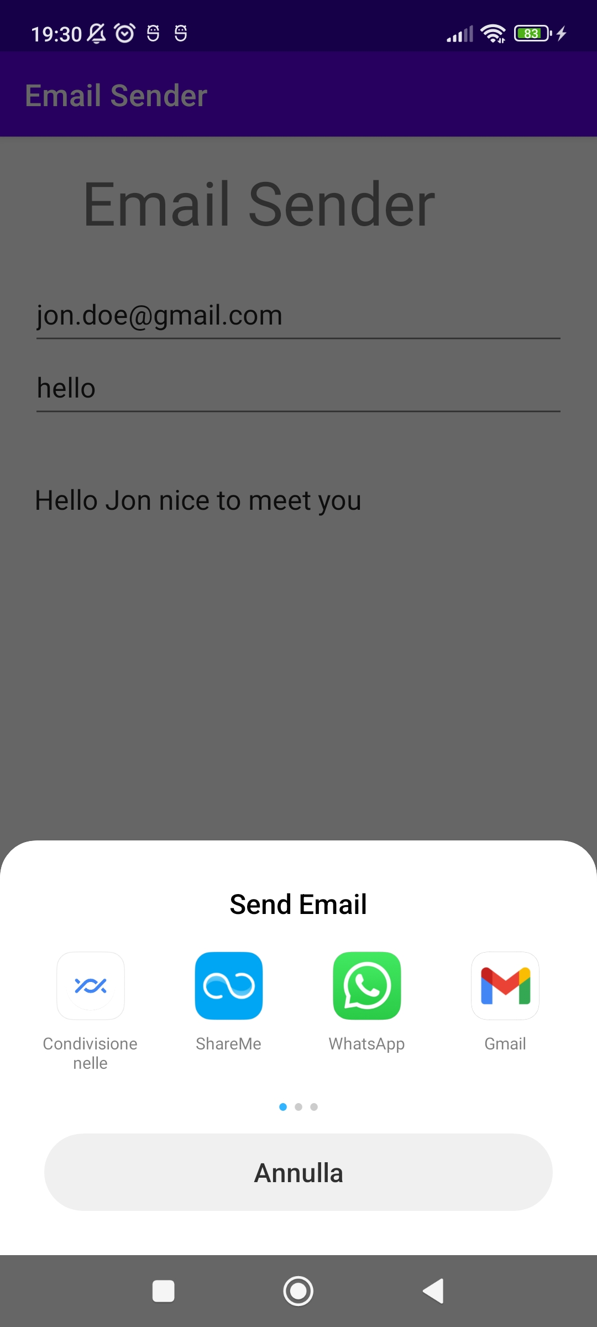
Example
When we use an intent that has set an action that can be performed by various app, system display the list and the user can choose.
An example is the intent.ACTION_SEND.
It's possible also create a chooser with the createChooser() method of Intent class.

Slide 44
Code
public class MainActivity extends AppCompatActivity {
EditText rec,subject,message; Button btn; @Override protected void onCreate(Bundle savedInstanceState) { super.onCreate(savedInstanceState); setContentView(R.layout.activity_main);
rec=indViewById(R.id.textTo); //email’s receivers subject=findViewById(R.id.textSubject); // email’s subject message=findViewById(R.id.textMessage); //email’s body btn=findViewById(R.id.buttonSend); btn.setOnClickListener(new View.OnClickListener() { @Override public void onClick(View view) { Intent intent = new Intent(Intent.ACTION_SEND); intent.setData(Uri.parse("mailto:")); String[] receivers=String.valueOf(rec.getText()).split(" ");
//add extra data for the app performing intent action intent.putExtra(Intent.EXTRA_EMAIL,receivers); intent.putExtra(Intent.EXTRA_SUBJECT,String.valueOf(subject.getText())); intent.putExtra(Intent.EXTRA_TEXT,message.getText()); //specify MIME type for Email intent.setType("message/rfc822");
//create Chooser Intent chooser=Intent.createChooser(intent,"Send Email"); startActivity(chooser); startActivity(intent); } }); }}

Slide 45
User interface design

Slide 46
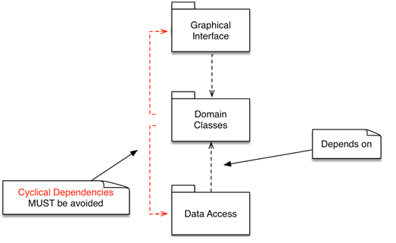
Intro
User interface is everything that the user can see and interact with.
In android you can create UI in Java or Kotlin code or using XML resources, is best practice using XML to guarantee separation of domain code from UI code, this approach makes possible the creation of different layout optimized for different hardware configurations (e.g. screen rotation, or screen size variation)
Android provides a variety of pre-built UI components such as structured layout objects and UI controls that allow you to build the graphical user interface for your app.
Android also provides other UI modules for special interfaces such as dialogs, notifications, and menus.

Slide 47
Density-independent design
The existing variety of different Android device (different screen sizes and form factors) leads us to not develop UI components using pixel such us unit of measurement.
You can abstract the variety of device density thinking in terms of density-independent pixels (dp) when having to set UI components size, dp represent physical sizes (two UI elements of the same size measured in dp, will appear to the user on screen both on oldest low-density device and on newest high-density screen)
You can thinking in terms of scalable pixel (sp) when having to set font size, sp are like dp but are also related with the user's preferred text size.

Slide 48
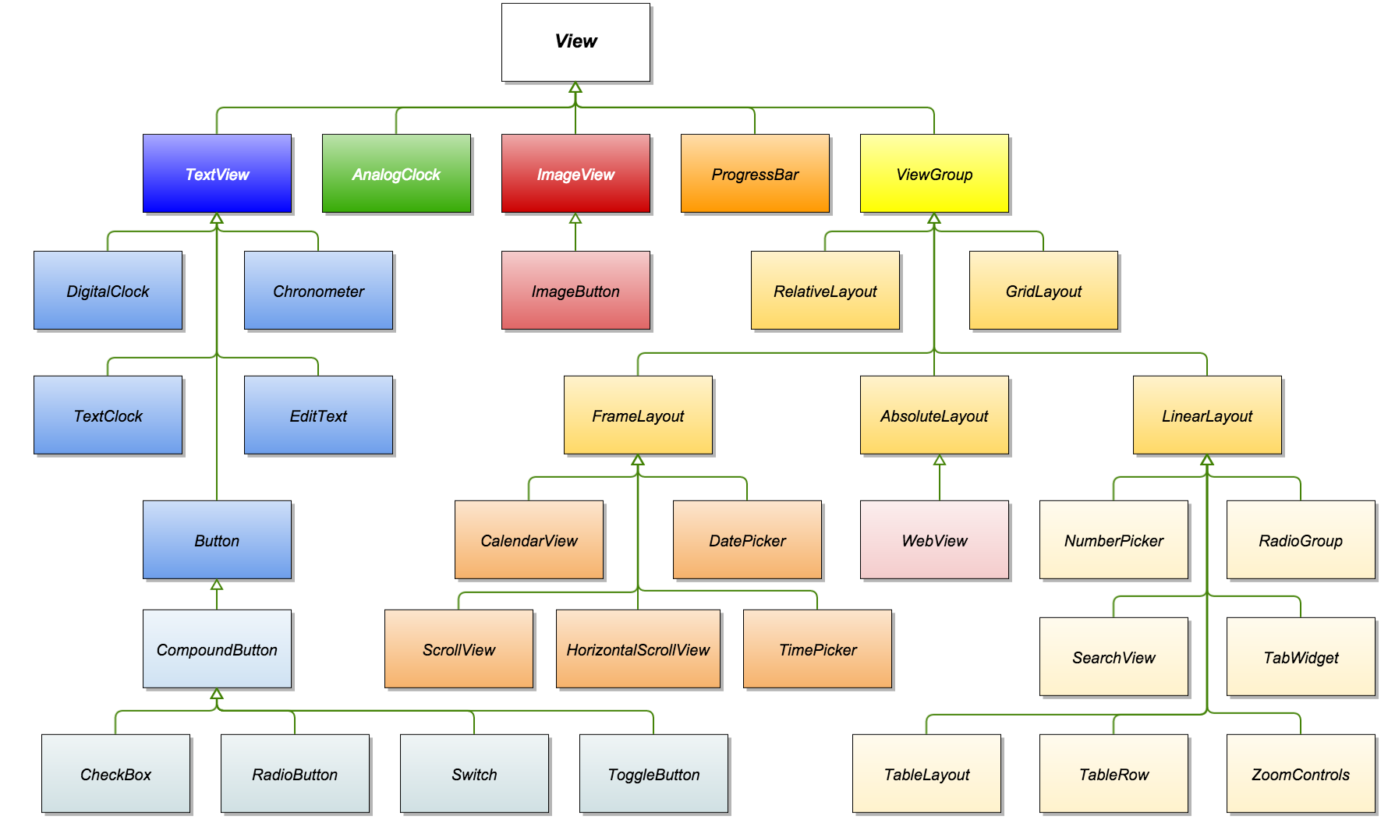
View hierarchy

Slide 49
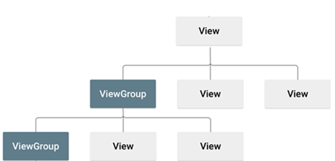
View hierarchy
All UI are built using View hierarchy, which is structured using composite pattern
ViewGroup: is an invisible container that defines the layout structure for View and other ViewGroup objects; are usually called "layouts"
View: represent individual UI elements (e.g. Button, TextView); are usually called "widgets" or "views"

Slide 50
Attributes
Every View and ViewGroup object supports their own variety of XML attributes.
There are different attributes
specific to a View object
common to all View objects, because they are inherited from the root View class
"layout parameters", that describe certain layout orientations of the View object

Slide 51
View
This class represents the basic building block for user interface components. A View occupies a rectangular area on the screen and is responsible for drawing and event handling.
View is the base class for widgets, which are used to create interactive UI components (buttons, text fields, etc.).

Slide 52
Initialize view
All of the views in a window are arranged in a single tree. You can add or remove views either from code or by XML layout files.
Once you have created a tree of views you have to setup all of them:
Set properties: set the attributes of the view in java file or in xml file
Set focus
Set up listeners: to manage user interaction and events
Set visibility: you can hide or show views using setVisibility(int)

Slide 53
View class XML attributes
Following are attributes contains in View class, they are inherited from every class which extends View. You can manage them both in code, using specific getters and setters, and in XML file.
id
any view object may have an integer ID associated with it, to uniquely identify the view within the tree. It is represented by an XML attributes and you can assign it as a string.
android:id="@+id/my_view"
Layout_width and layout_height
Any view has properties controlling the size of the view
android:layout_width="165dp"
android:layout_height="wrap_content"
For each dimension, it can specify one of:
Specific dimension value (165dp)
Wrap_content (which means that the view wants to be just big enough to enclose its content (plus padding))
Match_parent (which means the view wants to be as big as its parent (minus padding))
BEST PRACTISE: using dp units or wrap_content and match_parent is a better approach, because it helps ensure that your app will display properly across a variety of device screen sizes.

Slide 54
View class XML attributes
layout_margin
defines the amount of space around the outside of a view
padding
defines the amount of space around the contents or children of a view.
focusable
Controls whether a view can take focus. By default, this is "auto" which lets the framework determine whether a user can move focus to a view. By setting this attribute to true the view is allowed to take focus. By setting it to "false" the view will not take focus.
theme
Specifies a theme override for a view.
tooltipText
Defines text displayed in a small popup window on hover or long press.
textAllignment
Defines the alignment of the text.
gravity
determines the direction that the contents of a view will align

Slide 55
View class XML attributes
Visibility
Controls the initial visibility of the view.
May be one of this value
Gone: Completely hidden, as if the view had not been added.
Invisible: Not displayed, but taken into account during layout (space is left for it).
Visible: Visible on screen; the default value.
Alpha
alpha property of the view, as a value between 0 (completely transparent) and 1 (completely opaque).

Slide 56
View class XML attributes
Background
The value may be a drawable resource or a color
BackgroundTint
Tint to apply to the background.
May be a color value
BackgroundTintMode
Blending mode used to apply the background tint.
May be one of the following values: add, multiply, screen, src_atop, src_over, src_in
Foreground
Defines the drawable to draw over the content.
ForegroundGravity
Defines the gravity to apply to the foreground drawable.
ForegroundTint
Tint to apply to the foreground.
ForegroundTintMode
Blending mode used to apply the foreground tint.

Slide 57
View class method
For each of previous attributes exist getter and setter method in view class.
final <T extends View> T findViewById(int id)
Finds the first descendant view with the given ID, the view itself if the ID matches getId(), or null if the ID is invalid (< 0) or there is no matching view in the hierarchy.
final Context getContext()
Returns the context the view is running in, through which it can access the current theme, resources, etc.
View class provide methods which allow to manage events.

Slide 58
Input events
Events are a useful way to collect data about a user's interaction with interactive components of Applications.
Usually interactions with user are collected by UI component through touch-screen.
Android framework maintains an event que as FIFO basis.
Android provide different way to intercept the events from a user's interaction with your application:
Event listener: within the various view classes there are several public callback methods. This method are called by the android framework when the respective action occurs on that object. To intercept this, you must extend the classs and override the method. NOT PRACTICAL!! For this reason The View class contains a collection of interfaces, the event listeners, which are easy and practical to use and define. (we will see only this way)
Events handlers: are useful if you're building custom component from View and then you will be able to define several callback methods used as default event handlers

Slide 59
Event listeners
CALLBACK | INTERFACES | DESCRIPTION
onClick() | View.OnClickListener | This is called when the user either touches the item
onLogClick() | View.OnLongClickListener | This is called when the user either touches the item for one or more seconds
onFocusChange() | View.OnFocusChangeListener | This is called when the user navigates onto or away from the item, using the navigation-keys or trackball.
onKey() | View.OnKeyListener | This is called when the user is focused on the item and presses or releases a hardware key on the device.

Slide 60
Event listeners
CALLBACK | INTERFACES | DESCRIPTION
onTouch() | View.OnTouchListener | This is called when the user performs an action qualified as a touch event, including a press, a release, or any movement gesture on the screen (within the bounds of the item).
onCreateContextMenu() | View.OnCreateContextMenuListener | This is called when a Context Menu is being built (as the result of a sustained "long click").
These callback methods are the sole inhabitants of their respective interface. To define one of these methods and handle your events, implement the nested interface in your Activity or define it as an anonymous class. Then, pass an instance of your implementation to the respective View.set...Listener() method. (E.g., call setOnClickListener() and pass it your implementation of the OnClickListener.)

Slide 61
Binding views and event listener
There are different way to bind an event listener:
Using an Anonymous Inner Class in activity class
private OnClickListener listener = new OnClickListener() {
public void onClick(View v) {
// do something when the view is clicked }
};
protected void onCreate(Bundle savedValues) { ...
// Capture our button from layout
View view = findViewById(R.id.view); // Register the onClick listener with the implementation above button.setOnClickListener(listener); ... }
Activity class implements the Listener interface.
public class ExampleActivity extends Activity implements OnClickListener {
protected void onCreate(Bundle savedValues) { ...
View view = findViewById(R.id.view); button.setOnClickListener(this);
}
// Implement the OnClickListener callback
public void onClick(View v) {
// do something when the button is clicked
} ... }

Slide 62
Binding views and event listener
Using Layout file activity_main.xml to specify event handler directly.
Set android:onClick, assign to this attribute onClickListener created in the activity.
android:onClick="onClickListener"
The method you declare in the android:onClick attribute must have a signature exactly as shown above. Specifically, the method must:
Be public
Return void
Define a View as its only parameter (this will be the View that was clicked)

Slide 63
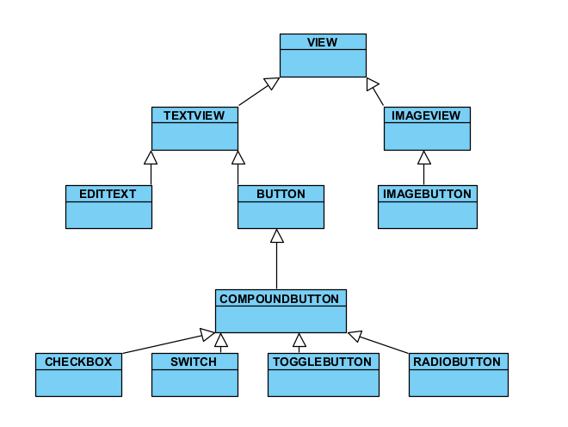
Android Widget Toolbox
Android provides a large number of widget. Following are the most used:
TextView
EditText
Button
ImageView
ImageButton
RadioButton
ToggleButton
Switch
CheckBox
Find an example app of widgets in code folder.

Slide 64
TextView
A user interface element that displays text to the user.
Specific TextView XML attributes:
android:capitalize
Android:editable
Andorid:fontFamily
Andorid:inputType
Android:password
Android:phoneNumber
Android:Text
Andorid:textAllCaps
Andorid:textColor
Andorid:textColorHighlight
android:textSize
Android:textStyle
Android:textIsSelectable
For each of this attributes TextView class provides getter and setter.

Slide 65
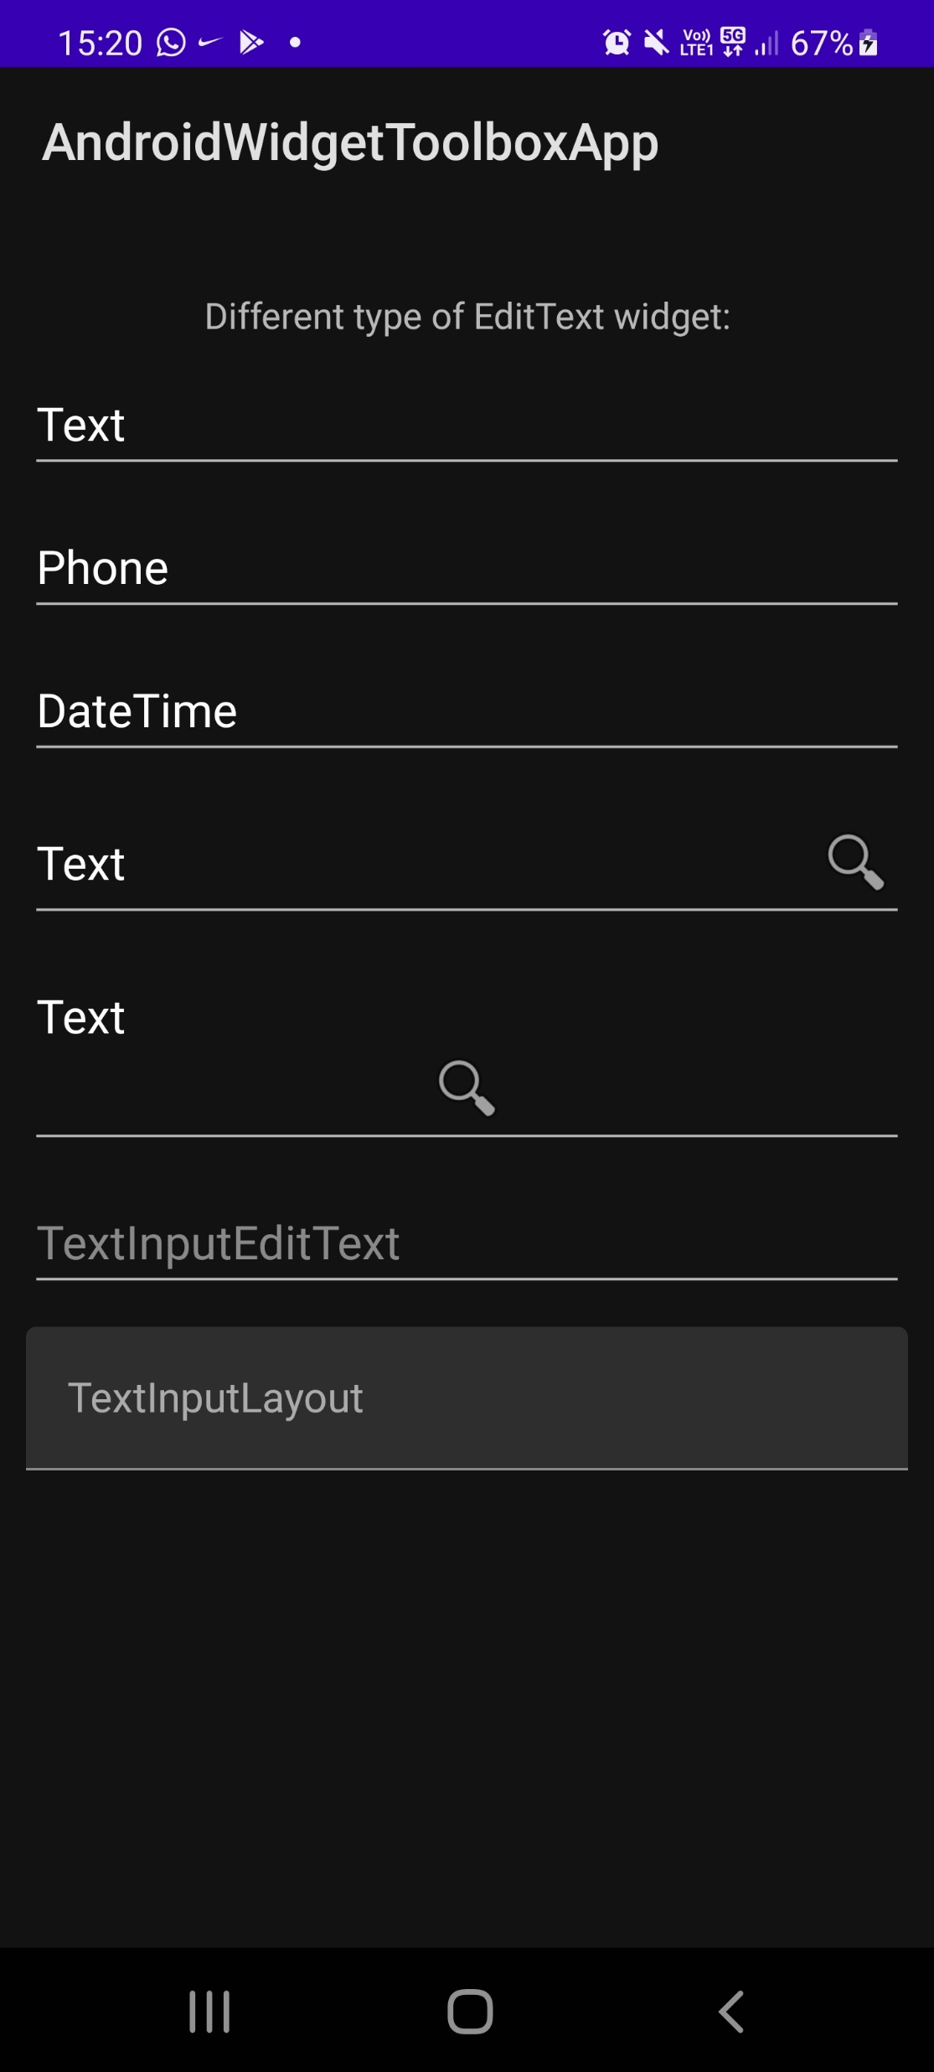
EditText
A user interface element for entering and modifying text. When you define an edit text widget, you must specify the R.styleable.TextView_inputType attribute. For example, for plain text input set inputType to "text".
Choosing the input type configures the keyboard type that is shown, acceptable characters, and appearance of the edit text.

Slide 66

Button and ImageButton
A button consists of text or an icon (or both text and an icon) that communicates what action occurs when the user touches it.
<Button
android:layout_width="wrap_content" android:layout_height="wrap_content" android:text="@string/button_text"/>
<ImageButton
android:layout_width="wrap_content"
android:layout_height="wrap_content"
android:src="@drawable/button_icon" android:contentDescription="@string/but ton_icon_desc"/>
<Button
android:layout_width="wrap_content"
android:layout_height="wrap_content"
android:text="@string/button_text" android:drawableLeft="@drawable/button_ icon"/>

Slide 67
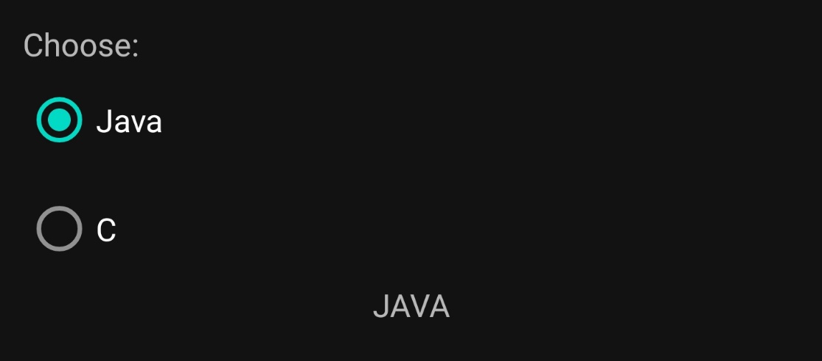
RadioButton
Radio buttons allow the user to select one option from a set. You should use radio buttons for optional sets that are mutually exclusive if you think that the user needs to see all available options side-by-side.
BEST PRACTISE: use RadioButton within RadioGroup.

Slide 68
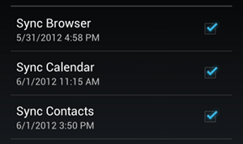
CheckBox
Checkboxes allow the user to select one or more options from a set. Typically, you should present each checkbox option in a vertical list.

Slide 69
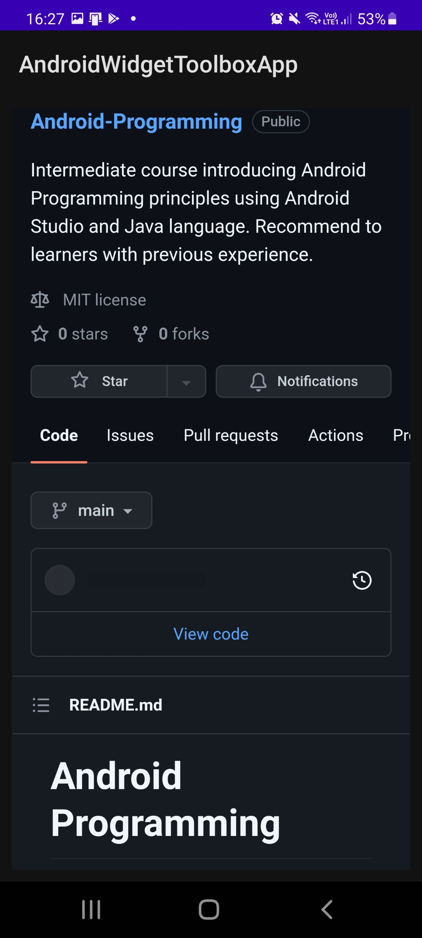
WebView
WebView objects allow you to display web content as part of your activity layout, but lack some of the features of fully-developed browsers.

Slide 70
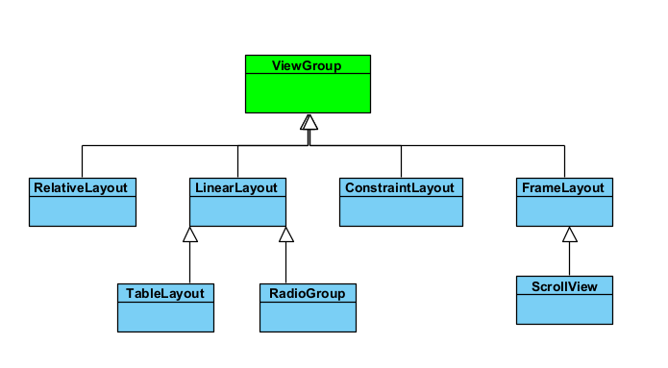
ViewGroup
The ViewGroup is a subclass of View and is the base class for layouts, which are invisible containers that hold other Views (or other ViewGroups) and define their layout properties.
Every subclass of ViewGroup provides a different layout structure
Most important layouts are:
ConstraintLayout
LinearLayout
RelativeLayout
FrameLayout
Most important views containers are:
ScrollView
RecyclerView
CardView

Slide 71
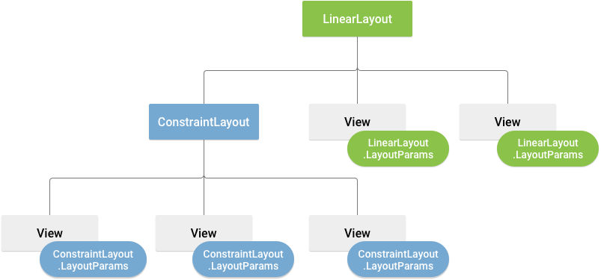
Layout parameters
XML layout attributes named layout_param_name define layout parameters for the View that are appropriate for the ViewGroup in which it resides.
Every ViewGroup class implements a nested class that extends ViewGroup.LayoutParams.
This subclass contains property types that define the size and position for each child view, as appropriate for the view group.

Slide 72
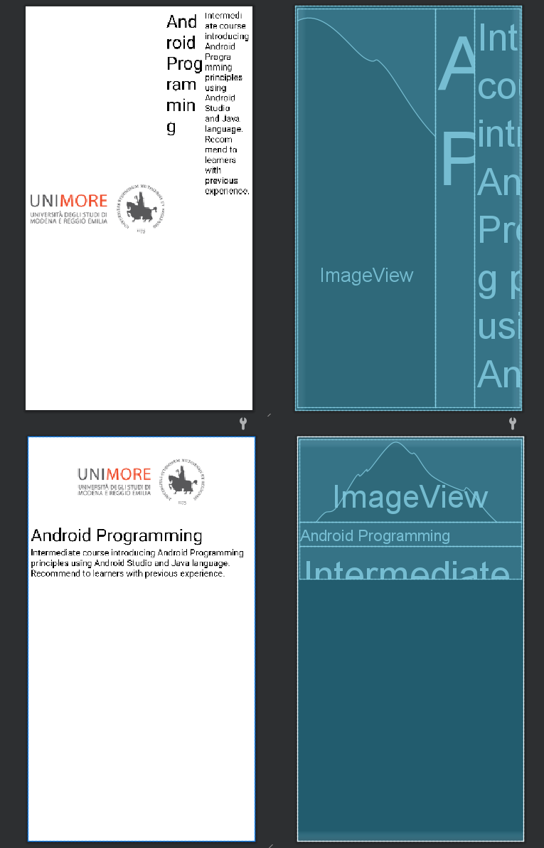
LinearLayout
This layout aligns its child views in either a vertical or horizontal line.
All children are stacked one after the other; only one child is contained in a single row or column

Slide 73
layout_weight
LinearLayout support supports assigning a weight to individual children with the android:layout_weight attribute.
This attribute assigns an "importance" value to a view in terms of how much space it should occupy on the screen. A larger weight value allows it to expand to fill any remaining space in the parent view.
Default weight is zero.

Slide 74
Children distribution
Equal distribution
Unequal distribution
To create a linear layout in which each child uses the same amount of space on the screen, set the android:layout_height of each view to "0dp" (for a vertical layout) or the android:layout_width of each view to "0dp" (for a horizontal layout). Then set the android:layout_weight of each view to "1".
You can also create linear layouts where the child elements use different amounts of space on the screen:
If there are three text fields and two of them declare a weight of 1, while the other is given no weight, the third text field without weight doesn't grow. Instead, this third text field occupies only the area required by its content. The other two text fields, on the other hand, expand equally to fill the space remaining after all three fields are measured.
If there are three text fields and two of them declare a weight of 1, while the third field is then given a weight of 2 (instead of 0), then it's now declared more important than both the others, so it gets half the total remaining space, while the first two share the rest equally.

Slide 75
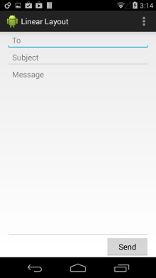
Unequal distribution example
<?xml version="1.0" encoding="utf-8"?> <LinearLayout xmlns:android="http://schemas.android.com/apk/res/android" android:layout_width="match_parent" android:layout_height="match_parent" android:paddingLeft="16dp" android:paddingRight="16dp" android:orientation="vertical" > <EditText android:layout_width="match_parent" android:layout_height="wrap_content" android:hint="@string/to" /> <EditText android:layout_width="match_parent" android:layout_height="wrap_content" android:hint="@string/subject" /> <EditText android:layout_width="match_parent" android:layout_height="0dp" android:layout_weight="1" android:gravity="top" android:hint="@string/message" /> <Button android:layout_width="100dp" android:layout_height="wrap_content" android:layout_gravity="right" android:text="@string/send" /> </LinearLayout>

Slide 76
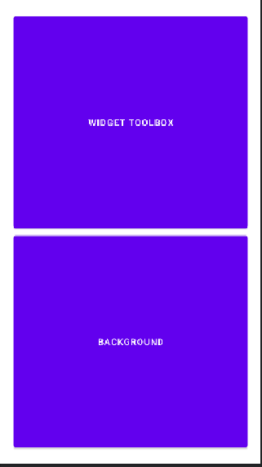
Equal distribution example
<?xml version="1.0" encoding="utf-8"?> <LinearLayout xmlns:android="http://schemas.android.com/apk/res/android" xmlns:app="http://schemas.android.com/apk/res-auto" xmlns:tools="http://schemas.android.com/tools" android:layout_width="match_parent" android:layout_height="match_parent" android:padding="20dp" android:orientation="vertical"> <Button android:id="@+id/button2" android:layout_width="match_parent" android:layout_height="0dp" android:layout_weight="1" android:text="Widget toolbox" /> <Button android:id="@+id/button3" android:layout_width="match_parent" android:layout_height="0dp" android:layout_weight="1" android:text="Background" /> </LinearLayout>

Slide 77
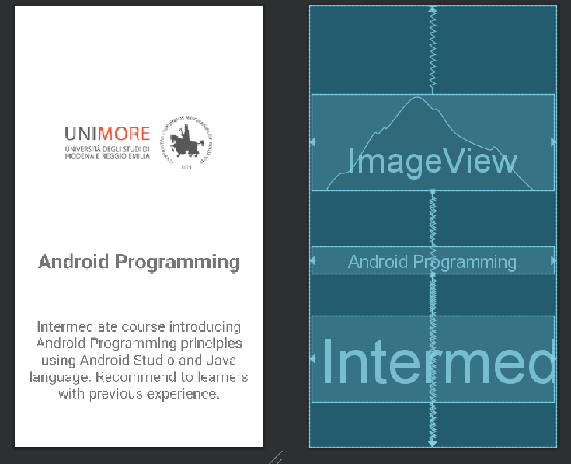
ConstraintLayout
The newest and reccomended layout.
Positions its child views throught a series of constraint.
This layout has its own Visual Layout Editor in Android studio (drag and drop)
===============================
Constraint layout guide: https://developer.android.com/training/constraint-layout

Slide 78
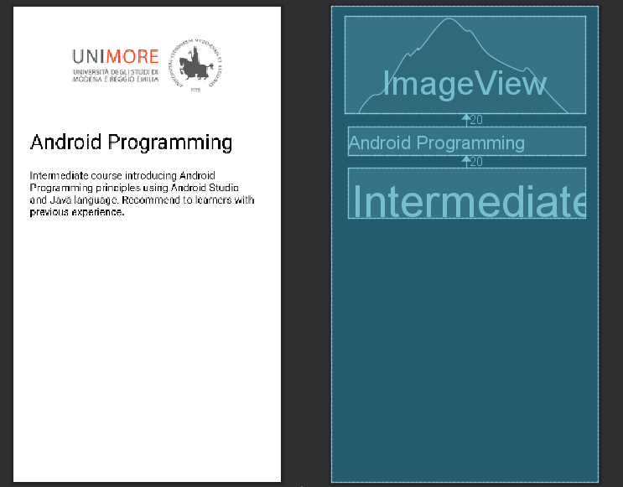
RelativeLayout
This layout is one of the most flessible, lets child views specify their position relative to the parent view or to each other (specified by ID).
By default, all child views are drawn at the top-left of the layout, so you must define the position of each view using the various layout properties available from RelativeLayout.LayoutParams.

Slide 79
RelativeLayout params
android:layout_alignParentTop
If "true", makes the top edge of this view match the top edge of the parent.
android:layout_centerVertical
If "true", centers this child vertically within its parent.
android:layout_below
Positions the top edge of this view below the view specified with a resource ID.
android:layout_toRightOf
Positions the left edge of this view to the right of the view specified with a resource ID.

Slide 80
Optimizing layout
Following are best practises to optimize layout and app performance.
Avoid Redundant Layout Container
Avoid excessive views
Reusing layout with <include> and <merge> tag
Android studio helps you to find this mistake through warning. In addition provides tools to analyze layout performance: Lint and Hierarchy Viewer.

Slide 81
Reusing layout
<include> tag
Allows you to add re-usable component in layouts, reusable component must be a layout.
Is possible to override any android:layout_* attributes when you include a layout
<merge> tag
helps eliminate redundant view groups in your view hierarchy when including one layout within another.
To avoid including such a redundant view group, you can instead use the <merge> element as the root view for the re-usable layout.
Now, when you include this layout in another layout (using the <include/> tag), the system ignores the <merge> element and places the two buttons directly in the layout, in place of the <include/> tag.

Slide 82
Reusing layout: <include>
CREATE REUSABLE LAYOUT: reusable_layout.xml
<?xml version="1.0" encoding="utf-8"?> <!-- This is a sample layout to explain <include> tag. This layout will be included in another layout: including_reusable_layout--> <androidx.constraintlayout.widget.ConstraintLayout xmlns:android="http://schemas.android.com/apk/res/android" android:layout_width="wrap_content" android:layout_height="wrap_content" android:layout_gravity="center_horizontal" android:padding="5dp" xmlns:app="http://schemas.android.com/apk/res-auto"> <TextView android:id="@+id/tv_reusable_button" android:layout_width="match_parent" android:layout_height="wrap_content" app:layout_constraintStart_toStartOf="parent" app:layout_constraintEnd_toEndOf="parent" app:layout_constraintTop_toTopOf="parent" android:text="Tap reusable button" android:gravity="center_horizontal"/> <Button android:layout_width="wrap_content" android:layout_height="wrap_content" android:text="Reuse me!" android:layout_marginTop="15dp" app:layout_constraintStart_toStartOf="parent" app:layout_constraintTop_toBottomOf="@id/tv_reusable_button" app:layout_constraintEnd_toEndOf="parent" /> </androidx.constraintlayout.widget.ConstraintLayout>
USE INCLUDE DIRECTIVE: including_reusable_layout.xml
<?xml version="1.0" encoding="utf-8"?> <!-- This is a sample layout to explain <include> tag. This layout include: reusable_layout and show how to use standard include directive and also show how to override attributes--> <LinearLayout xmlns:android="http://schemas.android.com/apk/res/android" android:layout_width="match_parent" android:layout_height="match_parent" android:padding="5dp" android:orientation="vertical"> <TextView android:layout_width="match_parent" android:layout_height="wrap_content" android:text="Layouts below are included:" android:gravity="center_horizontal"/> <include layout="@layout/reusable_layout"/> <TextView android:layout_width="match_parent" android:layout_height="wrap_content" android:text="you can also override attributes:" android:gravity="center_horizontal"/> <include android:id="@+id/l_override_reusable_layout" android:layout_height="wrap_content" android:layout_width="wrap_content" android:layout_gravity="end" layout="@layout/reusable_layout" /> </LinearLayout>

Slide 83
Reusing layout: <merge>
CREATE REUSABLE LAYOUT: reusable_layout_with_merge.xml
<?xml version="1.0" encoding="utf-8"?> <!-- This is a sample layout which show how to use <merge> tag--> <merge xmlns:android="http://schemas.android.com/apk/res/android" android:layout_width="match_parent" android:layout_height="match_parent"> <TextView android:id="@+id/tv_reusable_button" android:layout_width="match_parent" android:layout_height="wrap_content" android:text="Tap reusable button" android:gravity="center_horizontal"/> <Button android:layout_width="match_parent" android:layout_height="wrap_content" android:layout_marginTop="15dp" android:text="Reuse me!" /> </merge>
USE INCLUDE DIRECTIVE: including_reusable_layout.xml
<include layout="@layout/reusable_layout_with_merge"/>

Slide 84
Assign UI to an Activity
Activity class takes care of creating a window for you in which you can place your UI
Activity provides methods to set layout
public void setContentView (View view)
public void setContentView (int id)
Once layout has been set you can obtain a reference of each Views within it using:
public T findViewById (int id)
========================================
BEST PRACTISE: do UI elements initialization in onCreate()
public class HomeActivity extends AppCompatActivity { @Override protected void onCreate(Bundle savedInstanceState) { super.onCreate(savedInstanceState); setContentView(R.layout.activity_home); TextView tvHomePage = findViewById(R.id.tv_home); } }

